Slide 1
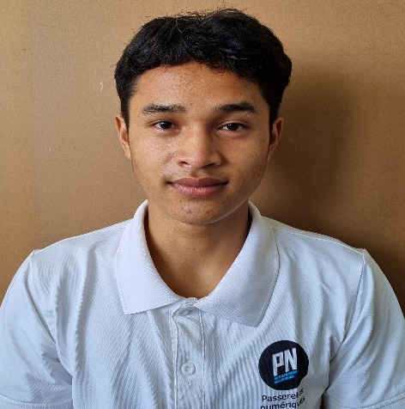



A THI
0355 279 217
thi.a24@student.
Passerellesnumeriques.org
Back-End Intern
101B, Le Huu Trac, Phuoc My, Son Tra, Da Nang
SOFT SKILLS
EDUCATION
Researching
Teamworking
Communicating
Problem-Solving
PASSERELLES NUMÉRIQUES VIETNAM
Bachelors in Information Technolog
Oct 2021 – Oct 2024
PROJECTS
TECHNICAL SKILLS
DOCTOR BOOKING WEBSITE Dec 2022 – Jan 2023
HTML, CSS, JavaScript, GitHub
Linking Mock API, JSON-Server to get Data
Designing validation for form login, logout, and register
Designing admin’s interface
Developing main functions: displaying, searching, adding
and deleting the user’s information and products
Storaging code using GitHub (Creating an individual branch, pulling code, pushing code, merging code, solving conflict …)
HTML & CSS
JavaScript
PHP
MySQL
LANGUAGE
Vietnamese
English
RESTAURANT MANAGEMENT Oct 2022 – Nov 2022
Workbench – MySQL
Designing a database (Creating a relationship between the Customer and the Restaurant table and other tables in a system)
Creating database objects such as Functions, Procedures, Views, and Triggers for easy searching, adding, updating, and deleting the products and users. And making contains among tables
Presenting the project
ACTIVITIES
Giving Gifts Nov 2022
Team member
Conduct street sales to earn money to buy gifts
Presenting project
INTERESTS
REFERENCE
Analyzing
Drinking coffee
Vo Cong Dinh IT Trainer
0905 729 707
dinh.cong@passerellesnumeriques.org

